Slide 1
Microservices

Slide 2
Microservices are an architectural and organizational approach to software development
where software is composed of small independent services that communicate over well-defined APIs.
These services are owned by small, self-contained teams.
Microservices architectures make applications easier to scale and faster to develop, enabling innovation and accelerating time-to-market for new features.
-Amazon AWS
https://aws.amazon.com/microservices/

Slide 3
Microservices
Also known as the microservice architecture
An architectural style that structures an application as a collection of services that are:
Independently deployable
Loosely coupled
Organized around business capabilities
Owned by a small team

Slide 4
“Do one thing and do it well”: the motto
Projects that are considered to be “microservices” follow Ken Thompson’s Unix philosophy:
“Do one thing and do it well”.
This can be summarized as: focus on one task, and perfect it.
This statement is not just relevant to programming, but also describes the functionality of individual microservices.

Slide 5
Microservices
Microservice architecture is basically a further development of service-oriented architecture (SOA): small services also play a role in this architectural pattern

Slide 6
Microservices
The microservice architecture enables an organization to deliver large, complex applications
rapidly,
frequently,
reliably and
sustainably - a necessity for competing and winning in today’s world.

Slide 7
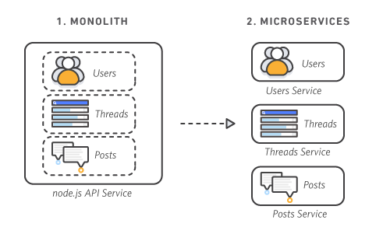
Monolithic vs. Microservices Architecture
With monolithic architectures, all processes are tightly coupled and run as a single service.
This means that if one process of the application experiences a spike in demand, the entire architecture must be scaled.

Slide 8
Monolithic vs. Microservices Architecture
Adding or improving a monolithic application’s features becomes more complex as the code base grows. This complexity limits experimentation and makes it difficult to implement new ideas.
Monolithic architectures add risk for application availability because many dependent and tightly coupled processes increase the impact of a single process failure.

Slide 9
Monolithic vs. Microservices Architecture
With a microservices architecture, an application is built as independent components that run each application process as a service.
These services communicate via a well-defined interface using lightweight APIs.

Slide 10
Monolithic vs. Microservices Architecture
Services are built for business capabilities and each service performs a single function.
Because they are independently run, each service can be updated, deployed, and scaled to meet demand for specific functions of an application.

Slide 11
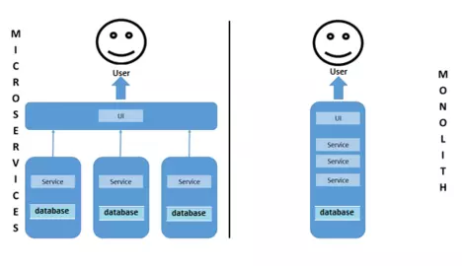
Monolithic vs. Microservices Architecture
While the monolith tries to combine everything in one application,
Microservices are only responsible for one task and run independently of each other.

Slide 12
Monolithic vs. Microservices Architecture
Traditional program development works according to monolith principles: all tasks are undertaken in one large project.
All individual services access a large database and are output through a user interface – everything is done in one application.

Slide 13
Monolithic vs. Microservices Architecture
The microservices approach is based on modules:
Each microservice is responsible for completing a simple task. Each work process is vastly different, as are often the results.

Slide 14
Monolithic vs. Microservices Architecture
When it comes to microservice architecture, each team is responsible for their own microservice,
whereas the structure is very different with monoliths.

Slide 15
Monolithic vs. Microservices Architecture
Teams are organized according to the technology they deal with:
one team deals with databases,
another one programs the individual services, and
a third one deals with the design of a user interface.
Other working groups are responsible for publishing updates, maintenance, and analysis.

Slide 16
Monolithic vs. Microservices Architecture
However, all teams in a monolith are interdependent.
Dependencies in microservice architecture should be avoided as much as possible.

Slide 17
Characteristics of Microservices
Autonomous
Each component service in a microservices architecture can be developed, deployed, operated, and scaled without affecting the functioning of other services.
Services do not need to share any of their code or implementation with other services.
Any communication between individual components happens via well-defined APIs.

Slide 18
Characteristics of Microservices
Specialized
Each service is designed for a set of capabilities and focuses on solving a specific problem.
If developers contribute more code to a service over time and the service becomes complex, it can be broken into smaller services.

Slide 19
Benefits of Microservices
Agility
Microservices foster an organization of small, independent teams that take ownership of their services. Teams act within a small and well understood context, and are empowered to work more independently and more quickly. This shortens development cycle times. You benefit significantly from the aggregate throughput of the organization.
Flexible Scaling
Microservices allow each service to be independently scaled to meet demand for the application feature it supports. This enables teams to right-size infrastructure needs, accurately measure the cost of a feature, and maintain availability if a service experiences a spike in demand.

Slide 20
Benefits of Microservices
Easy Deployment
Microservices enable continuous integration and continuous delivery, making it easy to try out new ideas and to roll back if something doesn’t work.
The low cost of failure enables experimentation, makes it easier to update code, and accelerates time-to-market for new features.
Technological Freedom
Microservices architectures don’t follow a “one size fits all” approach.
Teams have the freedom to choose the best tool to solve their specific problems. As a consequence, teams building microservices can choose the best tool for each job.

Slide 21
Benefits of Microservices
Reusable Code
Dividing software into small, well-defined modules enables teams to use functions for multiple purposes. A service written for a certain function can be used as a building block for another feature. This allows an application to bootstrap off itself, as developers can create new capabilities without writing code from scratch.
Resilience
Service independence increases an application’s resistance to failure. In a monolithic architecture, if a single component fails, it can cause the entire application to fail. With microservices, applications handle total service failure by degrading functionality and not crashing the entire application.

Slide 22
Working with microservices: 3 examples
Microservice architecture has now found its way into large company systems.
The companies have subsequently been able to fix certain problems or optimize their processes.
Some of them were already using modular systems when there was no term for them.

Slide 23
Working with microservices: 3 examples
Large companies with established monolithic systems changing to a microservice model.
Examples like
Netflix,
Spotify,
eBay
Other major IT companies like Google and Amazon also work like this.

Slide 24
Netflix
Like many other companies, Netflix used to be based on a monolithic system (back when Netflix was not an online streaming service, but only sent DVDs through the mail).
In 2008, there was an error in a database that caused the entire service to fail for four days.

Slide 25
Netflix
The decision was then taken to break up the old system and split them into microservices.
The result was that the company was able to
make live changes much faster, and
repairs were carried out much more quickly.

Slide 26
Netflix
Since the Netflix system is enormously extensive, a separate program was developed to organize the individual microservices among themselves:
Conductor
Conductor grants Netflix central control to pause, restart or scale their microservices.
https://www.ionos.com/digitalguide/websites/web-development/microservice-architecture/

Slide 27
Spotify
The audio streaming service Spotify also relies on microservices.
Spotify’s main daily development challenge is keeping ahead of the strong competition.
The audio streaming services market has some of the largest IT companies in the world as its main players – such as Amazon, Apple, and Google.

Slide 28
Spotify
Due to the increasing number of users, Spotify developers are constantly having to meet higher demands and comply with certain business rules (like licensing rights).
Microservices are a good solution for Spotify, allowing them to react quickly to new developments their competitors might make, and publish their own developments faster – forcing the competitors to react in turn.

Slide 29
Spotify
For example,
Spotify feature that recommends suggestions to users when they type in a search term is a self-contained microservice that has its own dedicated team working on it.
Additionally, Spotify benefits from the robust nature of microservice architecture: if a single microservice fails, it does not mean that the entire product becomes unusable.

Slide 30
Spotify
There are more than 800 microservices active within Spotify, and they use Java for a large part of those microservices.
However, this has nothing to do with the fact that microservices cannot be written in different programming languages: instead, it has to do with work processes.
Developers constantly move from one team to another, and it is easier when everyone uses the same language.

Slide 31
eBay
Like many other large systems,
the eBay sales platform began as a monolith:
eBay had 3.4 million lines of code in just one file.
The company then decided to break up the monolith and develop Java microservices instead.
Individual eBay services also use REST to communicate with one another.

Slide 32
Inference
The fact that eBay and other companies have successfully gone from a monolithic to microservice architecture is a clear sign of the benefits of a more modern approach.
While the monolith structure is perfectly sufficient in the early days of a website, with a small number of active users and a manageable range of products, it can become growth-inhibiting when demands start to increase.

